Slide 1
Benefits of IEEE Membership

Slide 2
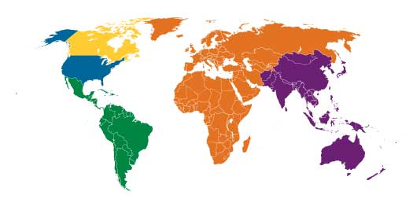







IEEE at a Glance
Our Global Reach
420,000+
Members
39
Technical Societies
160
Countries
Region 7
Regions 1 - 6
Region 8
Region 10
Our Technical Breadth
Region 9
1,800
Annual Conferences
4,000,000+
Technical Documents
170+
Top-cited Periodicals
Notes:
IEEE is broken up into 10 Geographic Regions
Each Region is broken down in smaller entities known as Sections
There are 334 Sections Worldwide
Sections range from major metropolitan areas to entire countries or states.
Within a Section can be a number of entities. Globally IEEE has:
+3,000 Student Branches
+2,000 Society Chapters
+480 Local Affinity Groups (Young Professional, Women in Engineering, Life Member, IEEE-USA Consultants Network & IEEE Entrepreneurship)

Slide 3







Your Local Member Experience
IEEE Local Volunteer & Member Efforts
Student Branch: University of Maribor IEEE Student Branch
IEEE Section: IEEE Slovenia Section, http://www.ieee.si/
5 Technical Societies Chapters, including:
Affinity Groups:
Notes:
This slide should be updated to reflect the appropriate information for your audience.
Graphics for many of the Societies, Affinity Groups, etc. can be found via their respective websites.
One speaking point would be to mention that most of the benefits that are discussed in the following slides are members-only benefits.

Slide 4

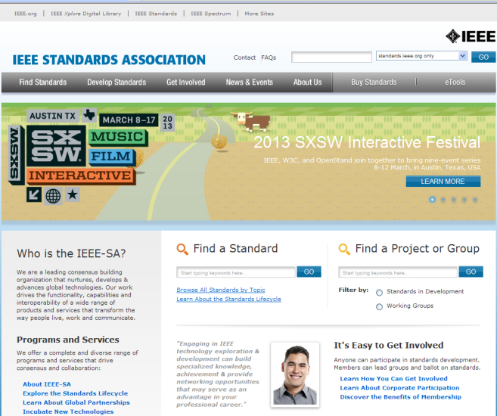
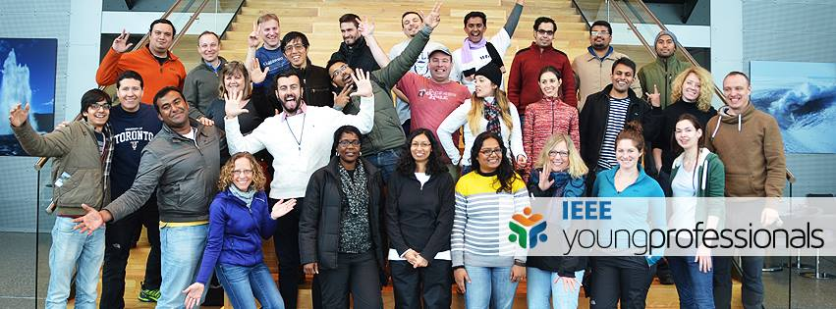
Special Interest Memberships
IEEE Society Membership
IEEE Standards Association
IEEE Women in Engineering
Affinity Groups
  Young Professionals
  Life Members
Notes:
IEEE Society membership enhances the benefits of IEEE membership
39 Societies representing a full spectrum of technical interests
Local technical chapters
Subscriptions and online content
Local technical chapters
Networking with innovators, experts, and practitioners
Members-only rates on additional publications
Volunteering opportunities
Technical committees
Journal editors
Conference organizers
Enabling and promoting the collaborative application of technical knowledge to advance economic and social well-being
IEEE Standards Association
Individual Membership
Engage in an unlimited number of Individual Projects
IEEE-SA Newswire, eTools
Standards Insight Blog
Member discounts
Participate in IEEE-SA Board of Governors & Elections
Corporate Membership
IEEE-SA Corporate Advisory Group
Unlimited Sponsor Balloting of Corporate Projects
Tiered number of complimentary IEEE-SA Individual Memberships
Participation in & nomination of employees for IEEE-SA Corporate Advisory Group (CAG) and Board of Governors (BOG) Elections
IEEE Women in Engineering
Facilitating the development of programs and activities that promote the entry into and retention of women in engineering programs
200+ local groups worldwide
RECOGNIZES women's outstanding achievements in electrical and electronics engineering through IEEE Awards nominations.
ORGANIZES receptions at major technical conferences to enhance networking and to promote membership in WIE.
ADVOCATES women in leadership roles in IEEE governance and career advancement for women in the profession.
PROVIDES assistance with the formation of new WIE Affinity Groups and supports ongoing activities.
PROMOTES IEEE Member Grade advancement for women to the grades of Senior Member and Fellow.
FACILITATES the development of programs and activities that promote the entry into and retention of women in engineering programs.

Slide 5
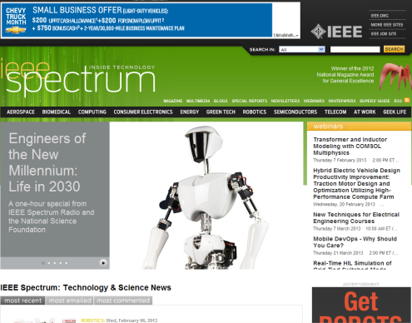
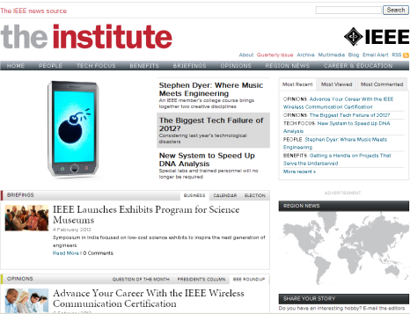
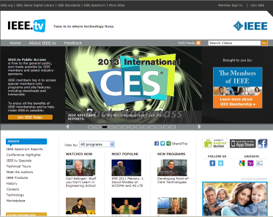
Stay Technically Current
Subscriptions to:
  IEEE Spectrum
  The Institute
Discounts on
  IEEE Xplore Articles
  IEEE-Wiley eBooks
  IEEE Events & Conferences
IEEE.tv - IEEE’s Internet television network
Notes:
IEEE Spectrum Magazine
Monthly, the award-winning IEEE Spectrum magazine explores the creation, application and implications of new technologies
The Institute Newsletter
Monthly (4 print, 8 online) newsworthy IEEE activities both in professional and technical areas
IEEE Xplore Digital Library
Table-of-contents and abstracts (nearly 2.0 million full-text documents)
IEEE-Wiley Press E-Books Classics
250+ digitized books downloadable from IEEE Xplore, with 6 new e-books added annually
IEEE.tv
IEEE’s Internet television network, with exclusive Member programming, downloading privileges, and transcripts

Slide 6
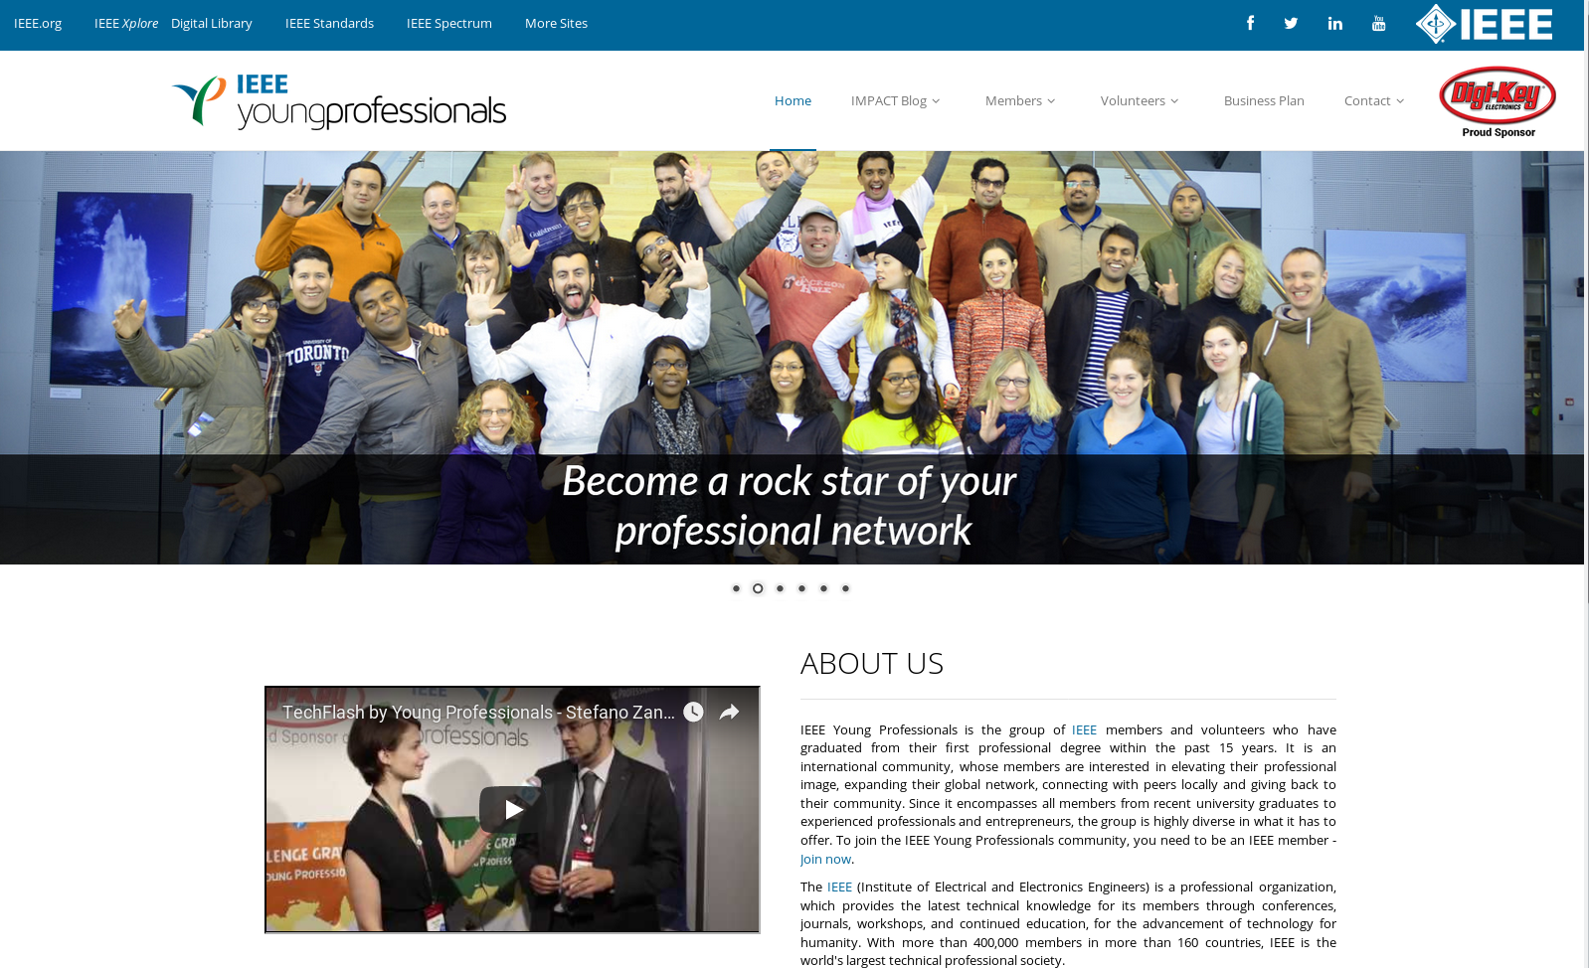

  Professional Networking
Local Section, Society Chapter and Student Branch Meetings & Events
IEEE CollabratecTM
Volunteering
Notes:
Sections, Student Branches, and Technical Chapters
Local, face-to-face technical and social meetings
Engage peers through informative technical meetings
Recognition of accomplishments
IEEE CollabratecTM
Connect with global technology professionals by location, technical interests, or career pursuits
Access research and collaborative authoring tools
Establish a professional identity to showcase key accomplishments
Gain access to the authoritative member directory of IEEE
Networks personalized to each member
Volunteering
Opportunities that build leadership skills and networking opportunities
Developing critical, non-technical skills that enable you to be more effective professionally
Humanitarian and Philanthropic Activities – Programs include: IEEE SIGHT, IEEE EPICS, IEEE Smart Village and many more. Visit: (www.ieee.org/doing-good
STEM Education Tools and programs -Introduction of engineering and technology to young people worldwide. Visit: tryengineering.org
Local and Regional Volunteer Opportunities – Become of part of the member volunteers who help deliver the value of IEEE locally.

Slide 7

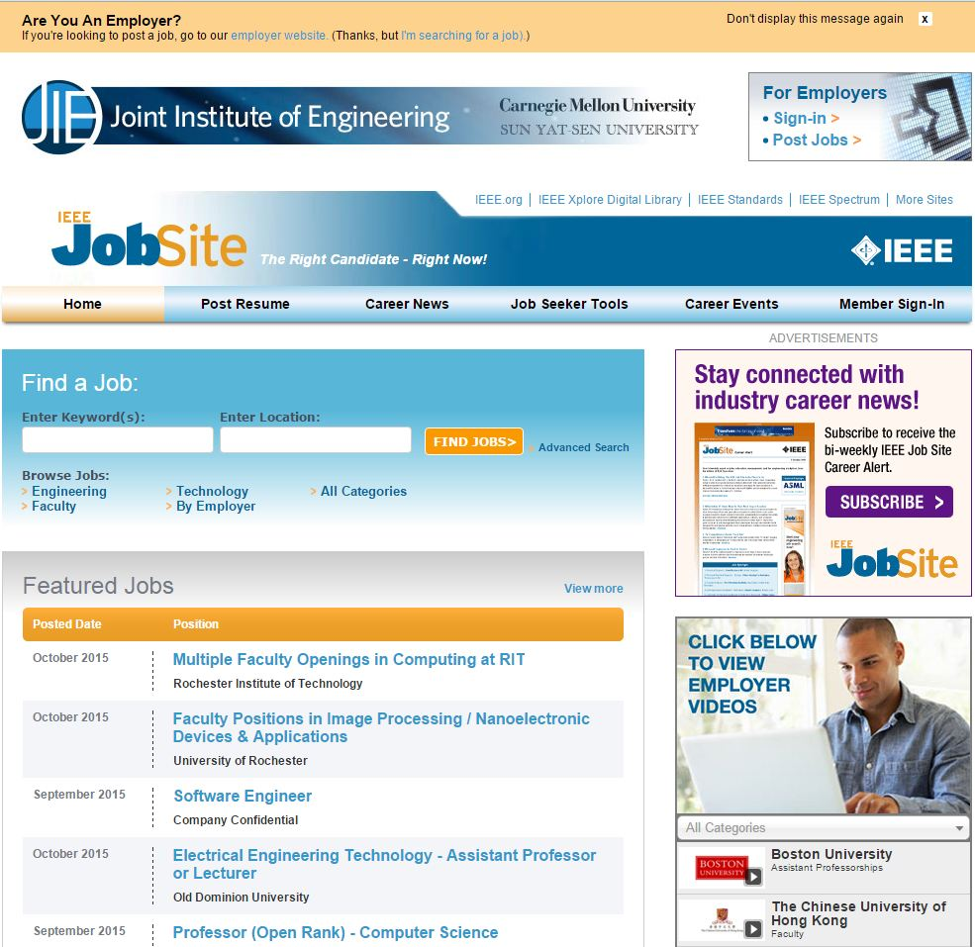


  Career Development & Services
IEEE JobSite w/ Career Alert
IEEE Mentoring via IEEE CollabratecTM
IEEE ResumeLab
IEEE Awards & Recognition
Notes:
IEEE Job Site, Career Alert
Locate career opportunities easily and confidentially
Career Alert is a bi-weekly email newsletter containing career advice
IEEE Mentoring via Collabratec
Peer-to-peer advice and counsel
Participate as either mentor or mentee
IEEE ResumeLab
Resume or curriculum vitae (CV): Develop your resume or CV using a number of different templates geared toward technical industries, sectors, and work-experience stages.
Develop your resume or CV using a number of different templates geared toward technical industries, sectors, and work-experience stages.
Letters: The interview process requires various types of letters, from a cover letter to a post-interview thank you letter. ResumeLab will help you develop these letters and assist you in communicating optimally throughout the hiring process.
Portfolio: Create your portfolio of work.
Skills assessment: Take a skills assessment to help you highlight skills you possess, your competency in these skills, and how your experience with these skills is unique.
Mock interview: Perform a mock interview to help prepare for the real thing. Choose your interviewer, types of questions, and whether you want to record yourself or not.
Video resume: Create a video resume or use the video function to record a custom video message to potential employers.
IEEE Awards & Recognition
Recognizes the accomplishments of IEEE members
Enhance your resume with an IEEE scholarship
Examples include:
Medal of Honor and Medals - IEEE Medals are at the top of the hierarchy of awards; the IEEE Medal of Honor is the highest award. IEEE Medals embrace significant and broad IEEE interests and purposes.
Technical Field Awards (TFA) - IEEE TFAs are bestowed for contributions or leadership in specific fields of interest of IEEE.
Recognitions - IEEE Recognitions are comprised of Service Awards, Corporate Awards, Prize Papers, Scholarships, Honorary Memberships, and an IEEE Staff Award.
Other Recognition Opportunities for IEEE Members - There are additional opportunities to honor the accomplishments of IEEE members within IEEE organizational units and partnering societies.

Slide 8
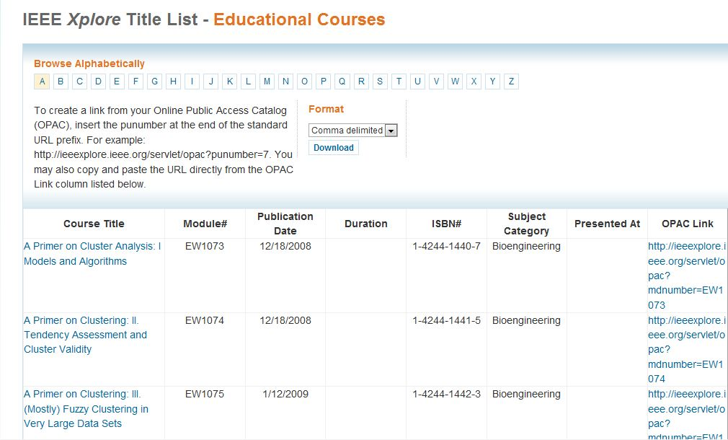
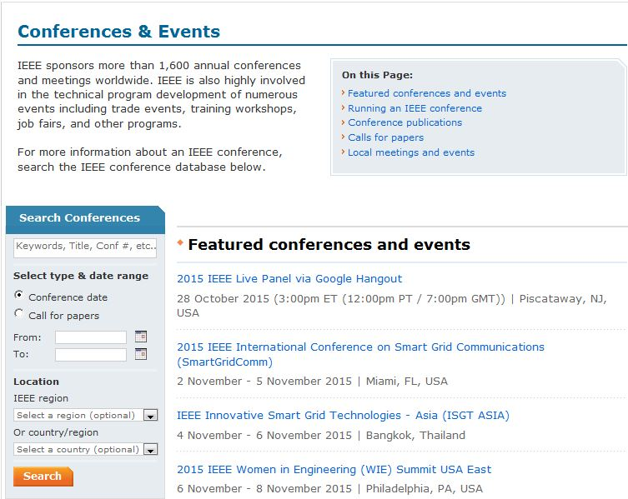
  Continuing Education
Continuing Education Partners Program
Discounted Pricing for IEEE Conferences and Events
Online Training
  IEEE eLearning Library
  IEEEx offered by edX
Earn Continuing Education Units (CEUs) & Professional Development Hours (PDHs)
Notes:
Continuing Education Partners Program
Up to a 10% discount on online degree programs
Discounted Pricing for IEEE Conferences and Events
These savings can be significant and easily offset the cost of membership for those who attend our conferences.
The actual savings varies by conference.
- Could be anywhere between $200 - $500
Online Training
IEEE eLearning Library are online courses offered through the IEEE Xplore library
Online tutorials enable you to get up to speed quickly on emerging technologies and trends.
Save time and money with content delivered when you need it—no travel required.
Learn from the leading experts in the field.
Increase your overall knowledge beyond your specific discipline to take advantage of technology convergence opportunities in the marketplace.
Find dynamic interface with audio, animation, engaging graphics, assessment, glossary, and references.
Tutorial topics span a wide array of technologies including: Aerospace; Bioengineering; Communication, Networking & Broadcasting; Components, Circuits, Devices & Systems; Computing; Engineering Profession; General Topics for Engineers; Photonics & Electro-Optics; Power, Energy & Industry Applications; Robotics & Control Systems; and Signal Processing & Analysis.

Slide 9


  Member Discounts/Reduced Rates
Reduced rates on IEEE Products
  As much as 50% off
Member Discounts* on:
  Financial Services
  Insurance Services
  Home & office Services
  Travel Services
* Benefits vary by country

Slide 10
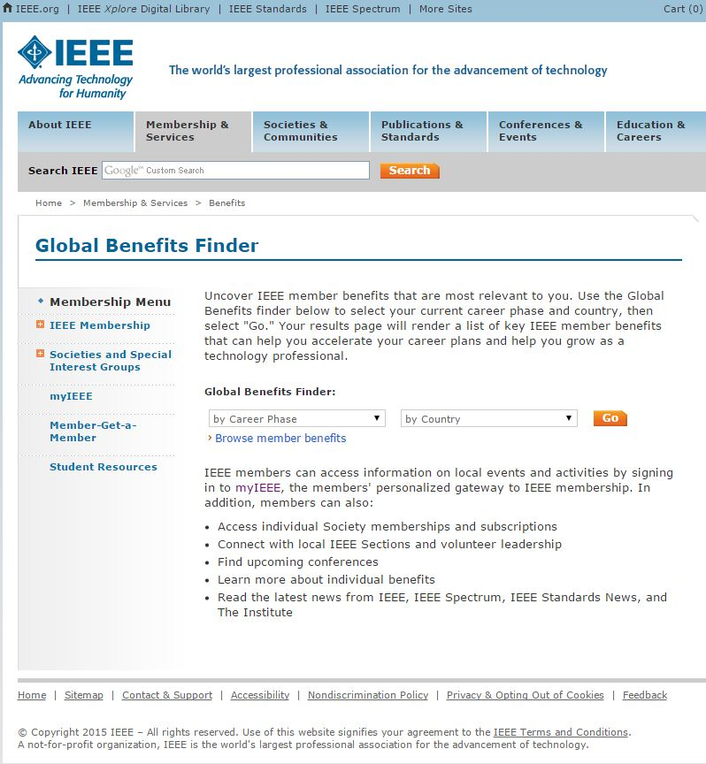
IEEE Global Benefits finder
Access all of the benefits in previous slides
Broken down by
  Career Phase
  Country
90+ Benefits for US Members
www.ieee.org/benefits

Slide 11
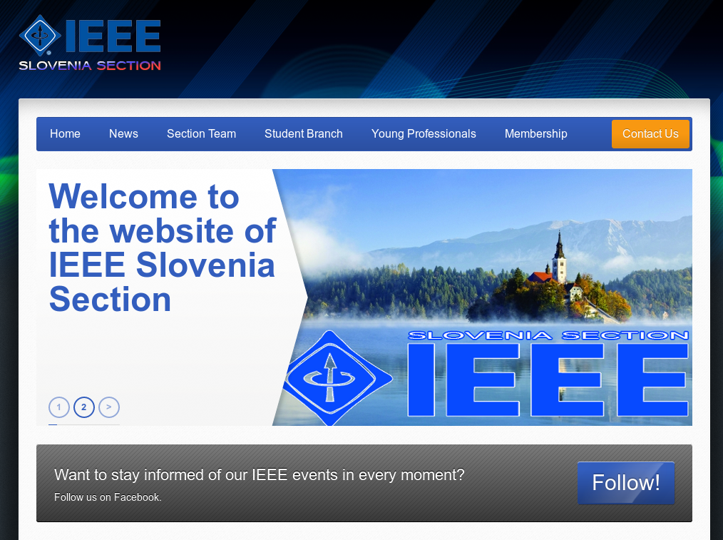




Want to see more of the IEEE Member Experience?
IEEE.tv Membership Experience Channel
Follow us on Social Media:
@IEEExp
IEEE Membership

Slide 12
Appendix

Slide 13
Important IEEE Links
IEEE Main website
  www.ieee.org
IEEE Membership and Subscriptions
  www.ieee.org/membership
  www.ieee.org/students
IEEE Societies and Communities
  http://www.ieee.org/societies_communities
IEEE Region and Section Website Access
  https://www.ieee.org/societies_communities/geo_activities/regional_world_map.html

Slide 14
Important IEEE Links
IEEE Conferences and Events
  http://www.ieee.org/conferences_events
  https://events.vtools.ieee.org/
IEEE Publications
  http://www.ieee.org/publications_standards
IEEE Standards
  http://standards.ieee.org/
IEEE Education Resources
  http://www.ieee.org/education_careers/index.html

Slide 15
Important IEEE Links
Humanitarian and Philanthropic Activities
  www.ieee.org/doing-good
IEEE Young Professional
  yp.ieee.org
IEEE Women In Engineering
  wie.ieee.org
IEEE Region 8
  https://ieeer8.org

